Slide 1
Improvements to Polynomial Multiplication Through Fast Fourier Transforms
David Lambropoulos
Demetrios Lambropoulos

Slide 2
Contents
Introduction/Motivation
Theory/Algorithms
Experimental Setup
Results and Analysis
Discussion

Slide 3
Contents
Introduction/Motivation
Theory/Algorithms
Experimental Setup
Results and Analysis
Discussion

Slide 4
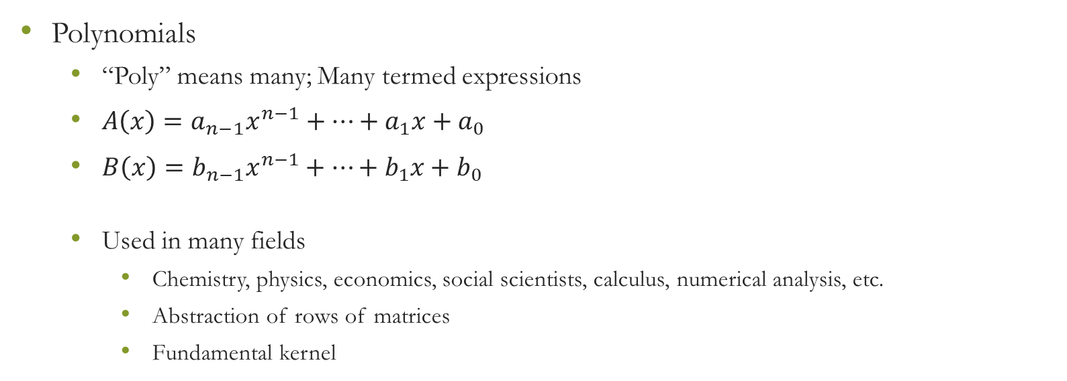
Introduction/Motivation
Polynomials
“Poly” means many; Many termed expressions
$A\left(x\right)=a_{n−1}x^{n−1}+…+a_{1}x+a_{0}$
$B\left(x\right)=b_{n−1}x^{n−1}+…+b_{1}x+b_{0}$
Used in many fields
Chemistry, physics, economics, social scientists, calculus, numerical analysis, etc.
Abstraction of rows of matrices
Fundamental kernel

Slide 5
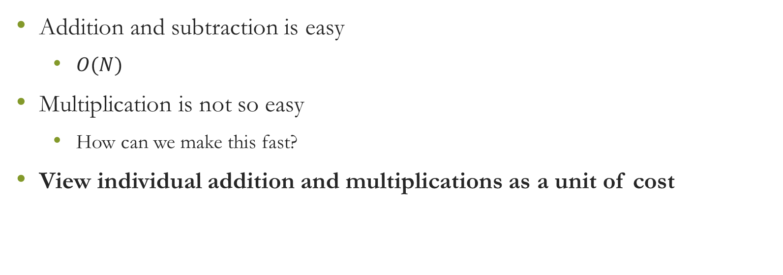
Introduction/Motivation
Addition and subtraction is easy
$O(N)$
Multiplication is not so easy
How can we make this fast?
View individual addition and multiplications as a unit of cost

Slide 6
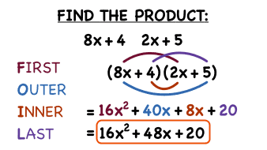
Introduction/Motivation
What’s the problem with standard methods (i.e., FOIL)?
Requires too many operations
TOO SLOW for large input
Could take lifetime for large enough input
Real world problems could have 10000+ terms

Slide 7
Introduction/Motivation
Scientific motivation
Solving large polynomial multiplication by hand is tedious and error prone
Solving large polynomial multiplications through quadratic algorithms would cost too much time

Slide 8

Introduction/Motivation
How to fix?
DIVIDE AND CONQUER

Slide 9
Contents
Introduction/Motivation
Theory/Algorithms
Experimental Setup
Results and Analysis
Discussion

Slide 10
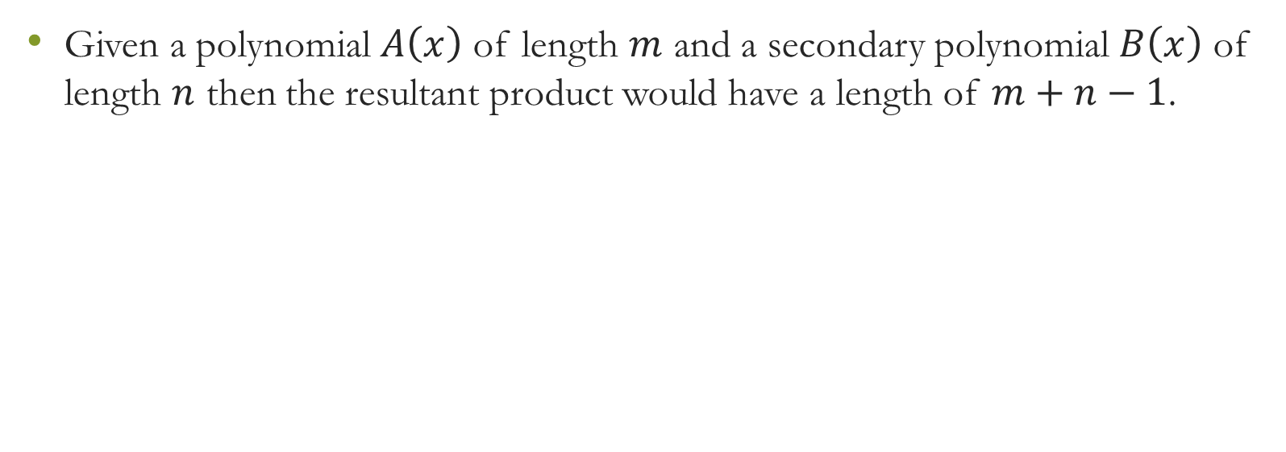
Theory/Algorithms – Polynomial Properties
Given a polynomial $A\left(x\right)$ of length $m$ and a secondary polynomial $B\left(x\right)$ of length $n$ then the resultant product would have a length of $m+n−1$.

Slide 11
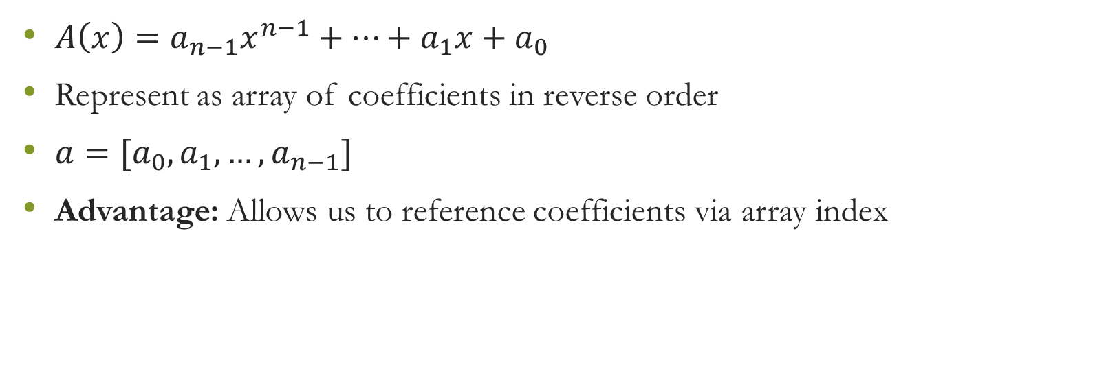
Representation as array
$A\left(x\right)=a_{n−1}x^{n−1}+…+a_{1}x+a_{0}$
Represent as array of coefficients in reverse order
$a=[a_{0}, a_{1},…, a_{n−1}]$
Advantage: Allows us to reference coefficients via array index

Slide 12
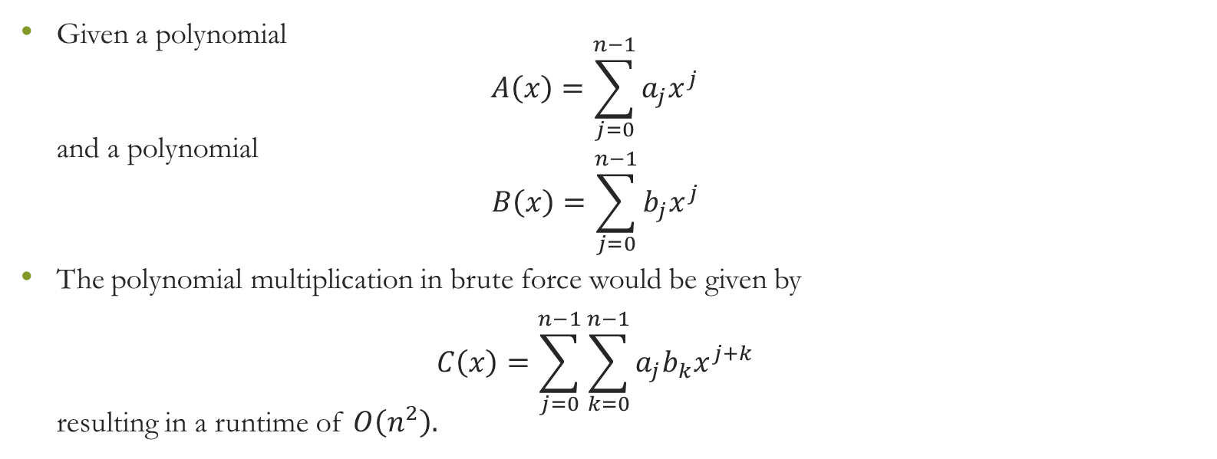
Theory/Algorithms – Brute Force
Given a polynomial $A\left(x\right)=\sum_{j=0}^{n−1}{a_{j}x^{j}}$ and a polynomial $B\left(x\right)=\sum_{j=0}^{n−1}{b_{j}x^{j}}$
The polynomial multiplication in brute force would be given by $C\left(x\right)=\sum_{j=0}^{n−1}{\sum_{k=0}^{n−1}{a_{j}b_{k}x^{j+k}}}$ resulting in a runtime of $O\left(n^{2}\right).$

Slide 13
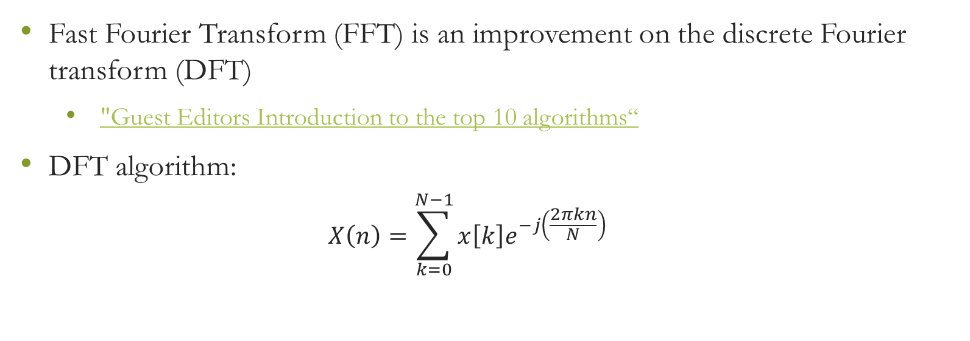
Theory/Algorithms – Fast Fourier Transform
Fast Fourier Transform (FFT) is an improvement on the discrete Fourier transform (DFT)
"Guest Editors Introduction to the top 10 algorithms“
DFT algorithm:
$$X\left(n\right)=\sum_{k=0}^{N−1}{x\left[k\right]e^{−j\left(\frac{2πkn}{N}\right)}}$$

Slide 14
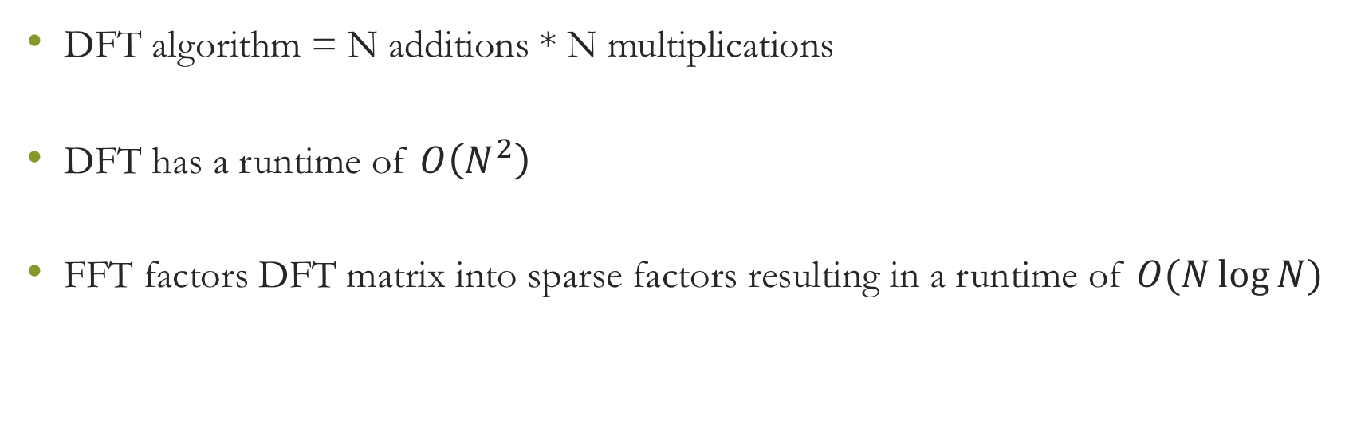
Theory/Algorithms – Fast Fourier Transform
DFT algorithm = N additions * N multiplications
DFT has a runtime of $O\left(N^{2}\right)$
FFT factors DFT matrix into sparse factors resulting in a runtime of $O(N\log{N})$

Slide 15
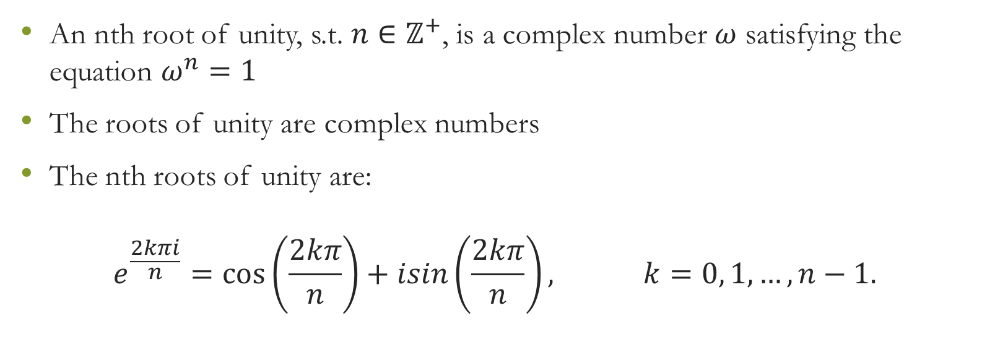
Theory/Algorithms – Roots of Unity
An nth root of unity, s.t. $n∈ℤ^{+}$, is a complex number $ω$ satisfying the equation $ω^{n}=1$
The roots of unity are complex numbers
The nth roots of unity are: $e^{\frac{2kπi}{n}}=\cos\left(\frac{2kπ}{n}\right)+isin\left(\frac{2kπ}{n}\right), k=0, 1, …, n−1.$

Slide 16
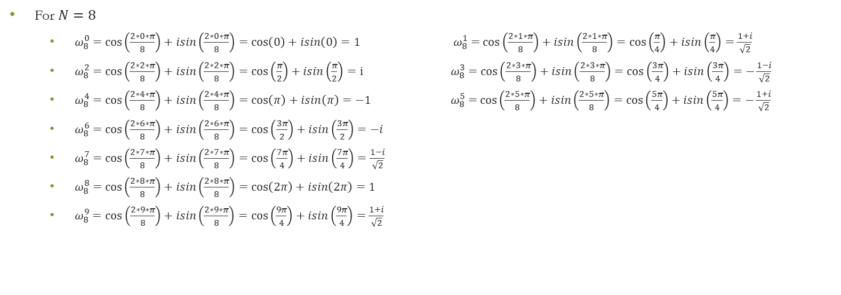
Theory/Algorithms – Roots of Unity
For $N=8$
$ω_{8}^{0}=$ $\cos\left(\frac{2∗0∗π}{8}\right)+isin\left(\frac{2∗0∗π}{8}\right)=\cos\left(0\right)+isin\left(0\right)=1 ω_{8}^{1}=$ $\cos\left(\frac{2∗1∗π}{8}\right)+isin\left(\frac{2∗1∗π}{8}\right)=\cos\left(\frac{π}{4}\right)+isin\left(\frac{π}{4}\right)=\frac{1+i}{\sqrt{2}}$
$ω_{8}^{2}=$ $\cos\left(\frac{2∗2∗π}{8}\right)+isin\left(\frac{2∗2∗π}{8}\right)=\cos\left(\frac{π}{2}\right)+isin\left(\frac{π}{2}\right)=i ω_{8}^{3}=$ $\cos\left(\frac{2∗3∗π}{8}\right)+isin\left(\frac{2∗3∗π}{8}\right)=\cos\left(\frac{3π}{4}\right)+isin\left(\frac{3π}{4}\right)=−\frac{1−i}{\sqrt{2}}$
$ω_{8}^{4}=$ $\cos\left(\frac{2∗4∗π}{8}\right)+isin\left(\frac{2∗4∗π}{8}\right)=\cos\left(π\right)+isin\left(π\right)=−1 ω_{8}^{5}=$ $\cos\left(\frac{2∗5∗π}{8}\right)+isin\left(\frac{2∗5∗π}{8}\right)=\cos\left(\frac{5π}{4}\right)+isin\left(\frac{5π}{4}\right)=−\frac{1+i}{\sqrt{2}}$
$ω_{8}^{6}=$ $\cos\left(\frac{2∗6∗π}{8}\right)+isin\left(\frac{2∗6∗π}{8}\right)=\cos\left(\frac{3π}{2}\right)+isin\left(\frac{3π}{2}\right)=−i$
$ω_{8}^{7}=$ $\cos\left(\frac{2∗7∗π}{8}\right)+isin\left(\frac{2∗7∗π}{8}\right)=\cos\left(\frac{7π}{4}\right)+isin\left(\frac{7π}{4}\right)=\frac{1−i}{\sqrt{2}}$
$ω_{8}^{8}=$ $\cos\left(\frac{2∗8∗π}{8}\right)+isin\left(\frac{2∗8∗π}{8}\right)=\cos\left(2π\right)+isin\left(2π\right)=1$
$ω_{8}^{9}=$ $\cos\left(\frac{2∗9∗π}{8}\right)+isin\left(\frac{2∗9∗π}{8}\right)=\cos\left(\frac{9π}{4}\right)+isin\left(\frac{9π}{4}\right)=\frac{1+i}{\sqrt{2}}$

Slide 17
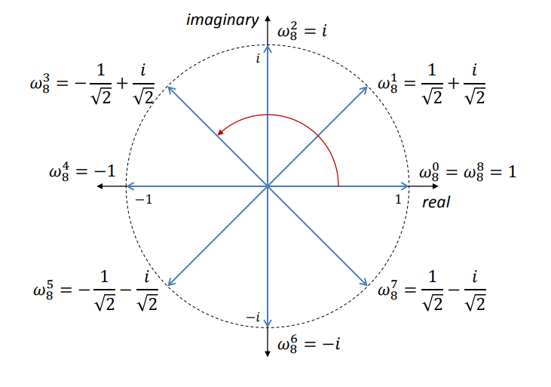
Theory/Algorithms – Roots of Unity

Slide 18
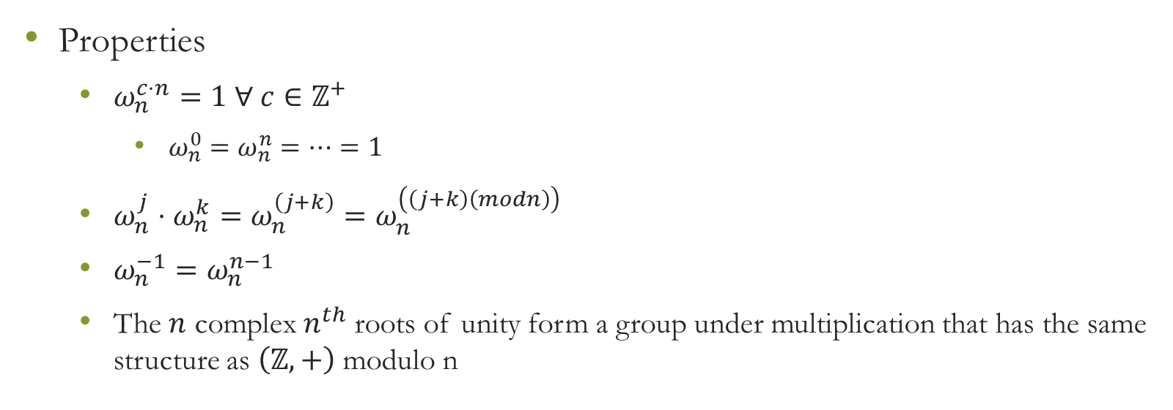
Theory/Algorithms – Roots of Unity
Properties
$ω_{n}^{c⋅n}=1 ∀ c∈ℤ^{+}$
$ω_{n}^{0}=ω_{n}^{n}=…=1$
$ω_{n}^{j}⋅ω_{n}^{k}=ω_{n}^{\left(j+k\right)}=ω_{n}^{\left(\left(j+k\right)\left(modn\right)\right)}$
$ω_{n}^{−1}=ω_{n}^{n−1}$
The $n$ complex $n^{th}$ roots of unity form a group under multiplication that has the same structure as $\left(ℤ,+\right)$ modulo n

Slide 19
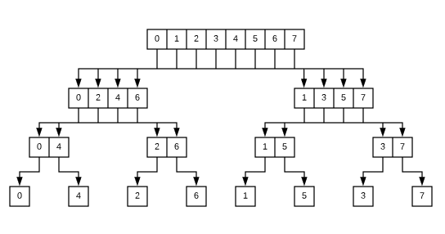
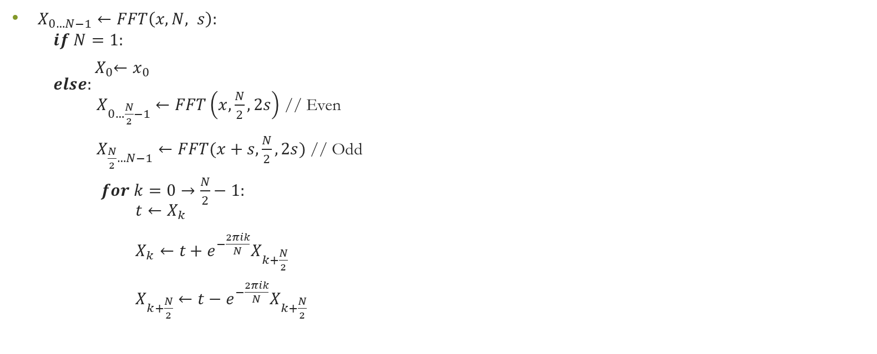
Theory/Algorithms – Fast Fourier Transform
$X_{0…N−1}←FFT\left(x, N, s\right):$ $if N=1:$
${ X}_{0}←x_{0}$ $else:$ $X_{0…\frac{N}{2}−1}←FFT\left(x,\frac{N}{2}, 2s\right)$ // Even $X_{\frac{N}{2}…N−1}←FFT(x+s,\frac{N}{2}, 2s)$ // Odd
$for k=0→\frac{N}{2}−1:$ $t←X_{k}$ $X_{k}←t+e^{−\frac{2πik}{N}}X_{k+\frac{N}{2}}$ $X_{k+\frac{N}{2}}←t−e^{−\frac{2πik}{N}}X_{k+\frac{N}{2}}$
Splitting array into even/odd array indices

Slide 20
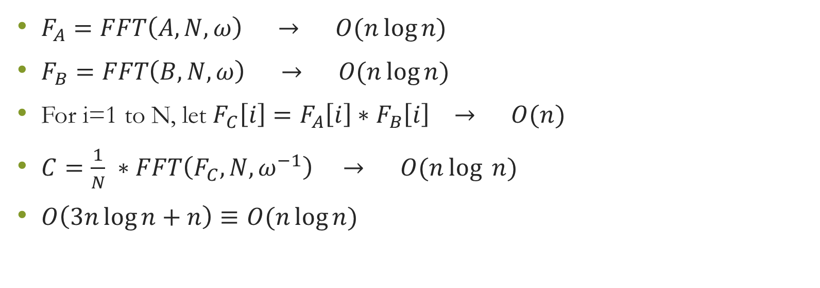
Theory/Algorithms – Final Algorithm
$F_{A}=FFT\left(A, N, ω\right) → O(n\log{n)}$
$F_{B}=FFT\left(B, N, ω\right) → O(n\log{n})$
For i=1 to N, let $F_{C}\left[i\right]=F_{A}\left[i\right]∗F_{B}\left[i\right] → O(n)$
$C=\frac{1}{N} ∗FFT\left(F_{C}, N, ω^{−1}\right) → O(n\log{ n})$
$O\left(3n\log{n}+n\right)≡O(n\log{n})$

Slide 21
Theory/Algorithms – Considerations
Arrays of indivisible sizes
Arrays of unequal size
How to fix?
Padding and Trimming

Slide 22
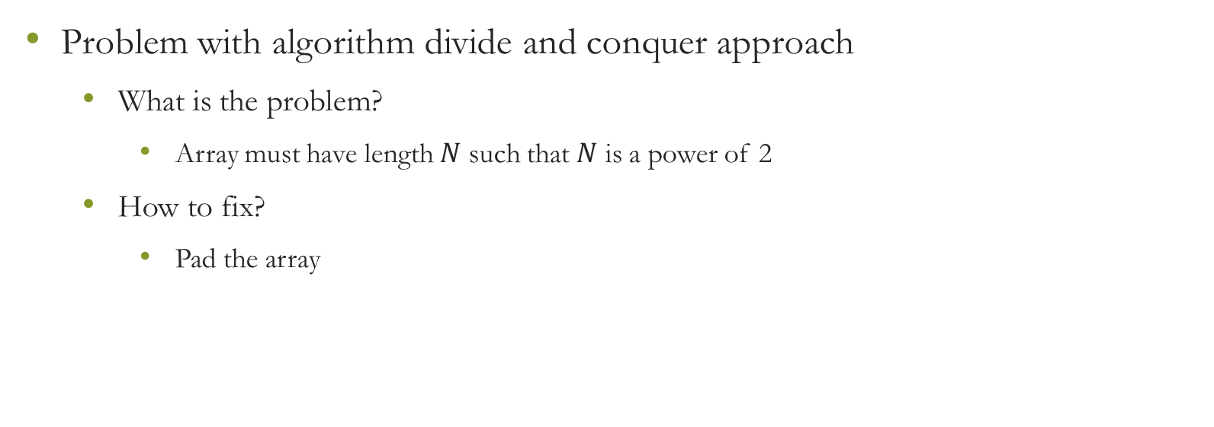
Theory/Algorithms – Padding
Problem with algorithm divide and conquer approach
What is the problem?
Array must have length $N$ such that $N$ is a power of 2
How to fix?
Pad the array

Slide 23
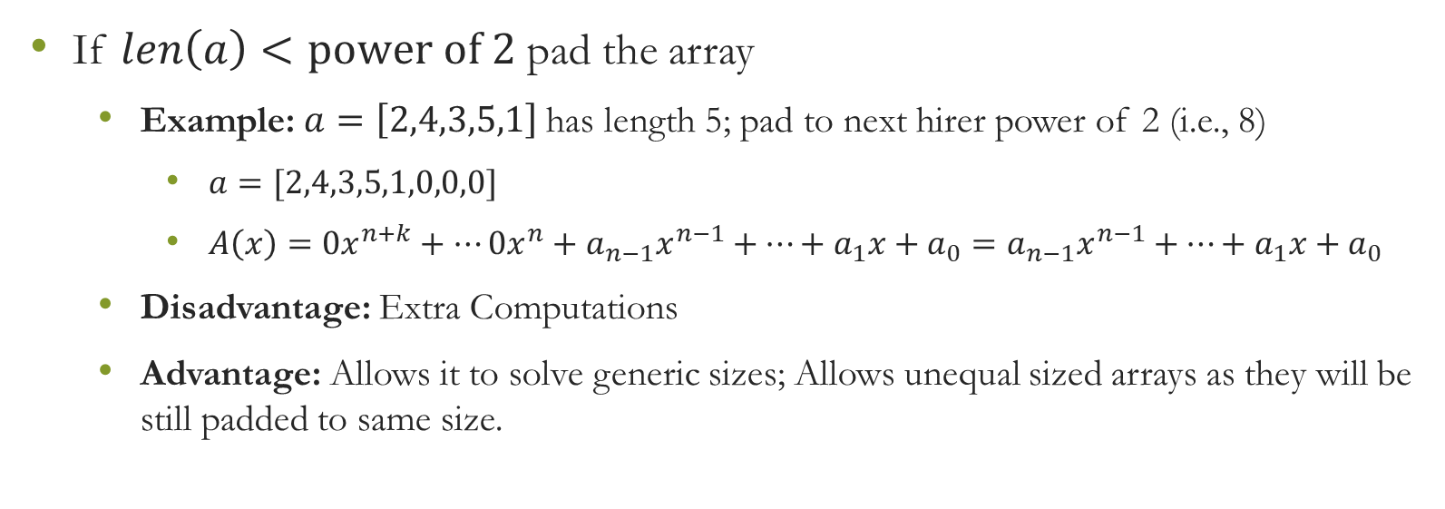
Theory/Algorithms – Padding
If $len\left(a\right)<power of 2$ pad the array
Example: $a=\left[2,4,3,5,1\right]$has length 5; pad to next hirer power of 2 (i.e., 8)
$a=[2,4,3,5,1,0,0,0]$
$A\left(x\right)=0x^{n+k}+…0x^{n}+a_{n−1}x^{n−1}+…+a_{1}x+a_{0}=a_{n−1}x^{n−1}+…+a_{1}x+a_{0}$
Disadvantage: Extra Computations
Advantage: Allows it to solve generic sizes; Allows unequal sized arrays as they will be still padded to same size.

Slide 24
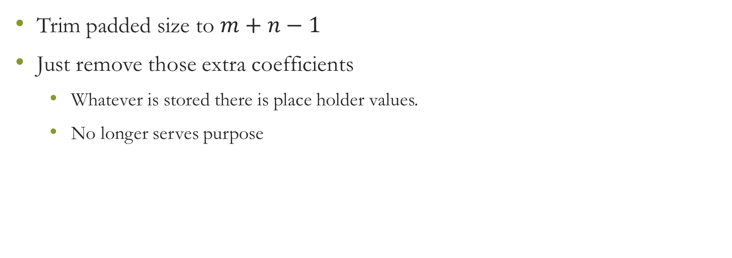
Theory/Algorithms – Trimming
Trim padded size to $m+n−1$
Just remove those extra coefficients
Whatever is stored there is place holder values.
No longer serves purpose

Slide 25
Contents
Introduction/Motivation
Theory/Algorithms
Experimental Setup
Results and Analysis
Discussion

Slide 26
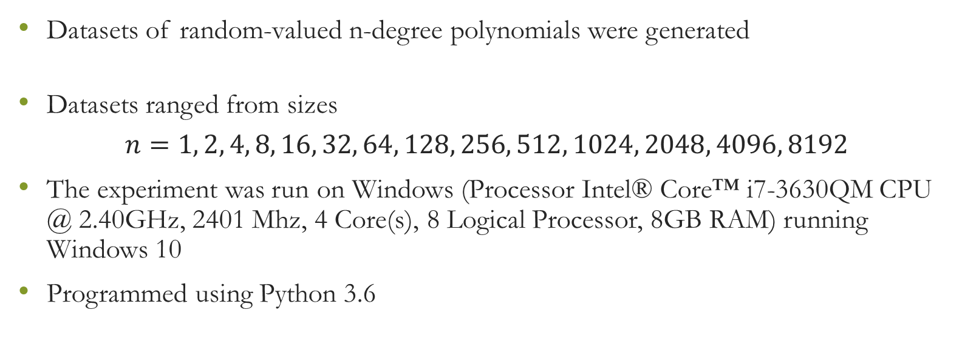
Experimental Setup
Datasets of random-valued n-degree polynomials were generated
Datasets ranged from sizes
$$n=1, 2, 4, 8, 16, 32, 64, 128, 256, 512, 1024, 2048, 4096, 8192$$
The experiment was run on Windows (Processor Intel® Core™ i7-3630QM CPU @ 2.40GHz, 2401 Mhz, 4 Core(s), 8 Logical Processor, 8GB RAM) running Windows 10
Programmed using Python 3.6

Slide 27
Contents
Introduction/Motivation
Theory/Algorithms
Experimental Setup
Results and Analysis
Discussion

Slide 28
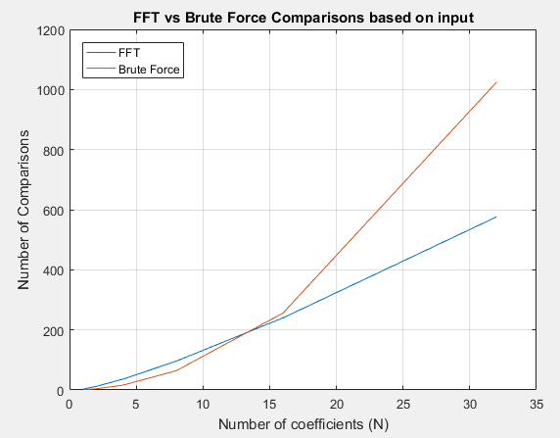
Results and Analysis

Slide 29
Results and Analysis
Zoomed in FFT has less assignments and comparisons in the long run
Small period where for small polynomials brute force outperforms the FFT

Slide 30
Results and Analysis

Slide 31
Results and Analysis
Just going up to 8192 terms shows that the FFT almost disappears in comparison to brute force

Slide 32
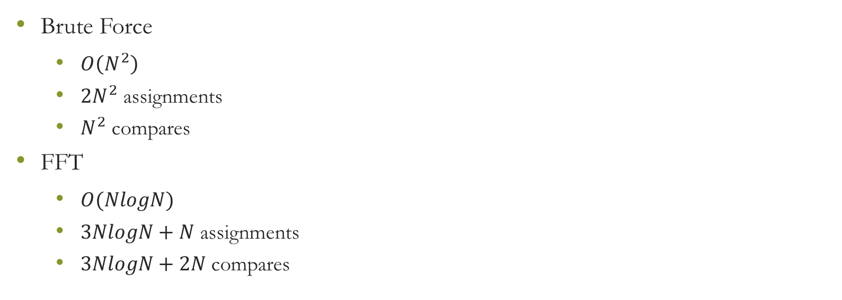
Results and Analysis
Brute Force
$O\left(N^{2}\right)$
$2N^{2}$ assignments
$N^{2}$ compares
FFT
$O(NlogN)$
$3NlogN+N$ assignments
$3NlogN+2N$ compares

Slide 33
Contents
Introduction/Motivation
Theory/Algorithms
Experimental Setup
Results and Analysis
Discussion

Slide 34
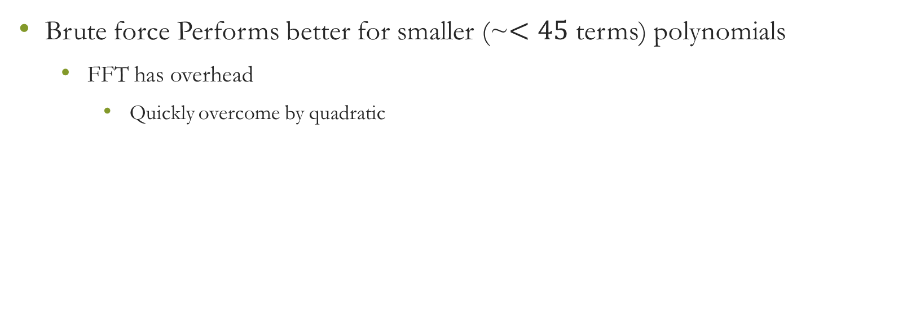
Discussion
Brute force Performs better for smaller (~$<45$ terms) polynomials
FFT has overhead
Quickly overcome by quadratic

Slide 35
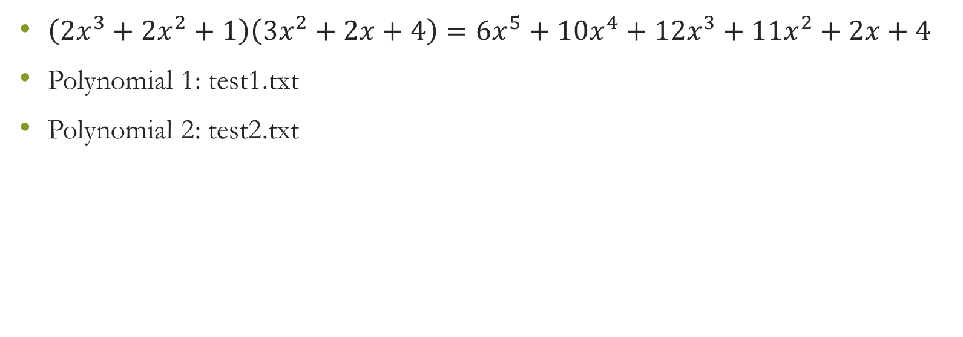
Demo
$\left(2x^{3}+2x^{2}+1\right)\left(3x^{2}+2x+4\right)=6x^{5}+10x^{4}+12x^{3}+11x^{2}+2x+4$
Polynomial 1: test1.txt
Polynomial 2: test2.txt
test1.txt
test2.txt
1
0
2
2
3
2
4
Polynomial 1: [1 0 2 2]
Polynomial 2: [3 2 4]

Slide 36
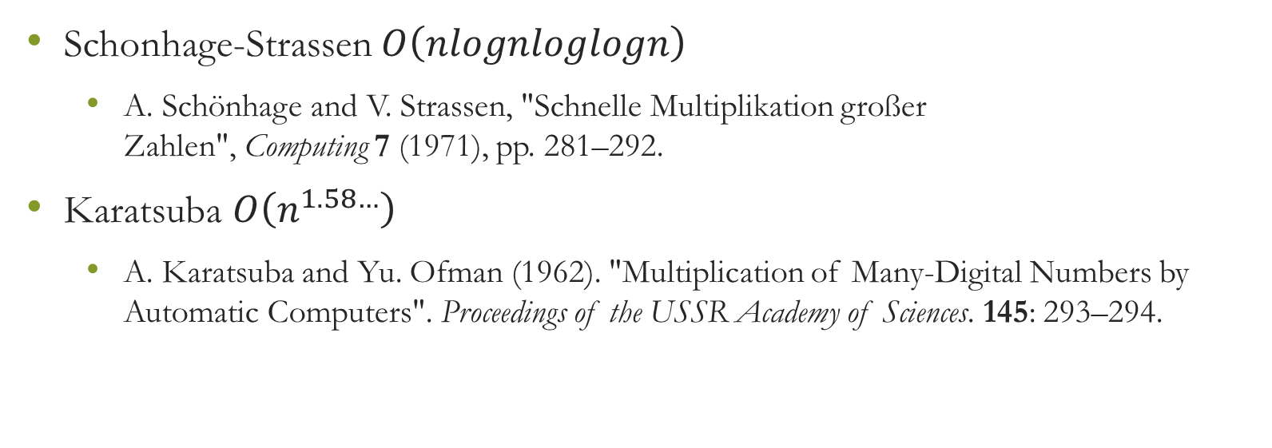
Further
Schonhage-Strassen $O\left(nlognloglogn\right)$
A. Schönhage and V. Strassen, "Schnelle Multiplikation großer Zahlen", Computing 7 (1971), pp. 281–292.
Karatsuba $O\left(n^{1.58…}\right)$
A. Karatsuba and Yu. Ofman (1962). "Multiplication of Many-Digital Numbers by Automatic Computers". Proceedings of the USSR Academy of Sciences. 145: 293–294.

Slide 37
References
http://cdn.virtualnerd.com/thumbnails/Alg1_6_1_4-diagram_thumb-lg.png
https://raindrops.in/snoeyink/view/5412ea354251df49689db061
https://www.cs.cmu.edu/afs/cs/academic/class/15451-s10/www/lectures/lect0423.txt
https://medium.com/@aiswaryamathur/understanding-fast-fourier-transform-from-scratch-to-solve-polynomial-multiplication-8018d511162f
http://web.cecs.pdx.edu/~maier/cs584/Lectures/lect07b-11-MG.pdf

